Slide 1
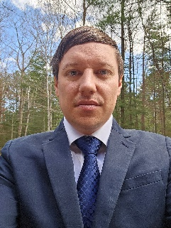
Nicholas Brown Sr. Consultant
Cloud & Product
Email
nicholas.brown@thebridge.com
Location
Marquette, MI
Mobile
(805) 440-5499
EXPERIENCE
Nick joined The Bridge in January 2024. He has experience in software consulting as part of Bridgeworks Consulting Group, as well as his own LLC.
Industry Experience
Design | Development | CI/CD | Azure | SQL | JavaScript | TypeScript | C# | React | Power Platform
Data Manipulation | Human Capital Management
Assisted with data import, data manipulation, and customer expectation management
Assisted in several areas:
Use PostgreSQL to create and manage complex functions for manipulating data
Use Pentaho Data Integration software to develop pipelines for importing, manipulating, and extracting sensitive customer data
Interfacing with the client’s tech team to ensure all data transactions proceed as planned with clear expectations
Full Stack Development | Construction Materials
Sole developer on their Customer Portal application, which included:
.NET back end
Typescript/React/Redux front end
SQL Server database management using Entity Framework
Identity Server API authentication
Administration tools for user management, customer management, and complex payment scenarios
Assist in developing Model-Driven and Canvas power apps that use other Power Platform technologies such as:
Power Automate
Power Pages
Dataverse
BACKGROUND
Functional Skills
Software Design, Software Implementation, Software Documentation, Backend Engineering, Frontend Engineering
Qualifications
A proven asset on any software development team, Nick has been in the software development industry since 2016. His experience spans across multiple industries and his focus on complex problem solving, client communication, and team cohesion set him apart from many of his peers.

Slide 2
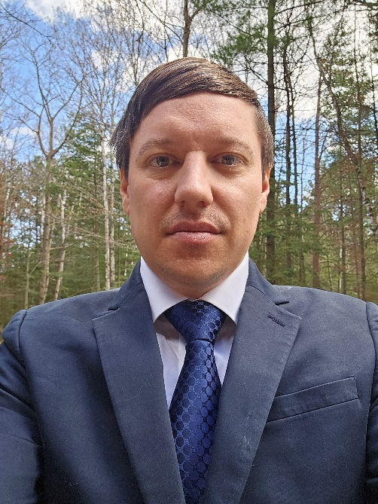

Email
nicholas.brown@thebridge.com
Location
Marquette, MI
Mobile
(805) 440-5499
Nick joined The Bridge in January 2024. He has previously worked in software consulting on a wide variety of projects designing and implementing software solutions for clients in multiple industries.
Nicholas Brown
Sr. Consultant
Cloud & Product

Slide 3

Nicholas Brown Sr. Consultant — Cloud & Product
Email
nicholas.brown@thebridge.com
Mobile
(805) 440-5499
Location
Marquette, MI
BACKGROUND
EXPERIENCE
Functional Skills
Software Design, Software Implementation, Software Documentation, Backend Engineering, Frontend Engineering, Cloud Engineering, DevOps Engineering
Qualifications
A proven asset on any software development team, Nick has been in the software development industry since 2016. His experience spans across multiple industries and his focus on complex problem solving, client communication, and team cohesion set him apart from many of his peers.
Industry Experience
Design | Development | CI/CD | SQL | JavaScript | TypeScript | React | Azure | .NET | Git | Power Platform
Data Manipulation | Human Capital Management
Assisted with data import, data manipulation, and customer expectation management
Assisted in several areas:
Use PostgreSQL to create and manage complex functions for manipulating data
Use Pentaho Data Integration software to develop pipelines for importing, manipulating, and extracting sensitive customer data
Interfacing with the client’s tech team to ensure all data transactions proceed as planned with clear expectations
Full Stack Development | Construction Materials
Sole developer on their Customer Portal application, which included:
.NET back end
Typescript/React/Redux front end
SQL Server database management using Entity Framework
Identity Server API authentication
Administration tools for user management, customer management, and complex payment scenarios
Assist in developing Model-Driven and Canvas power apps that use other Power Platform technologies such as:
Power Automate
Power Pages
Dataverse

